Slide 1
Yacc – Yet another compiler compiler
Dr G sudha Sadasivam

Slide 2
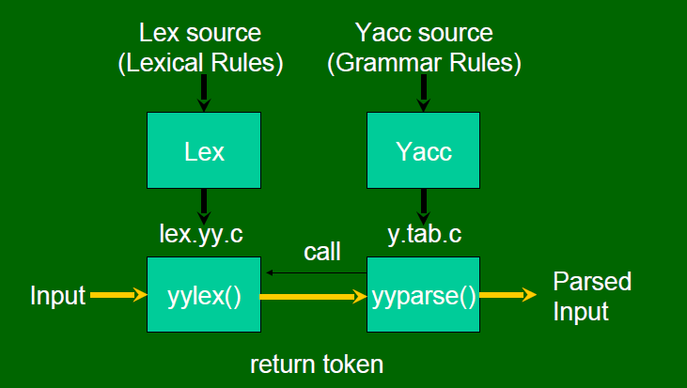
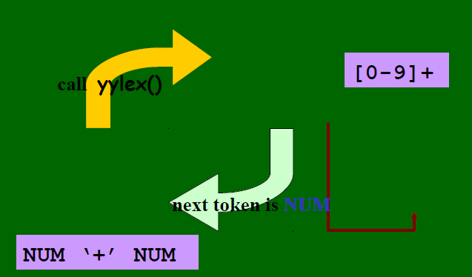
Lex generates C code for lexical analyser
YACC generates C Code for syntax analyser (LALR(1))
It analyses tokens from Lex and creates a syntax tree

Slide 3
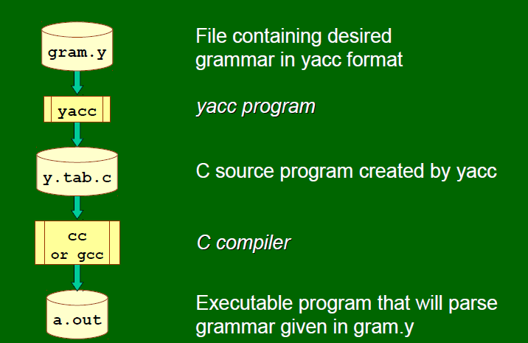

Slide 4
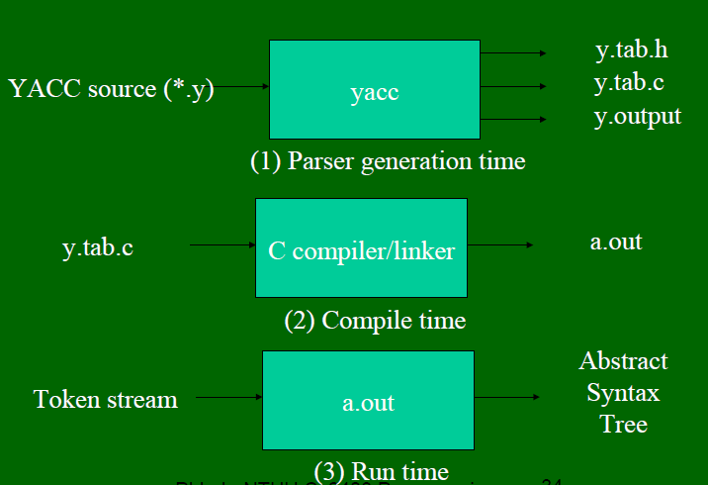

Slide 5
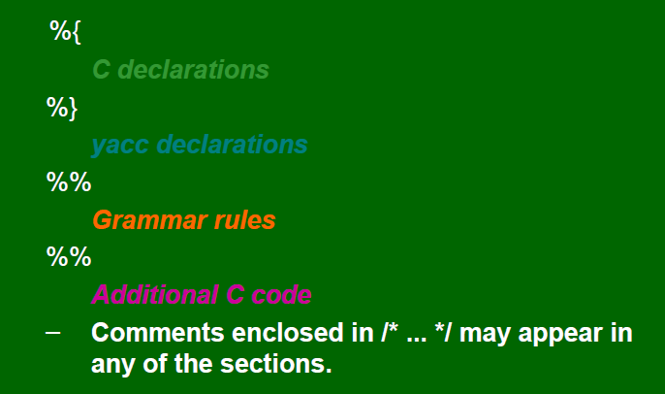

Slide 6
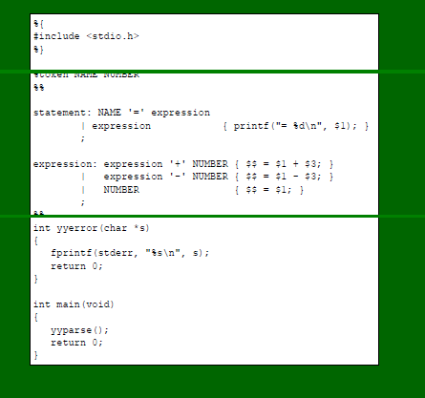

Slide 7
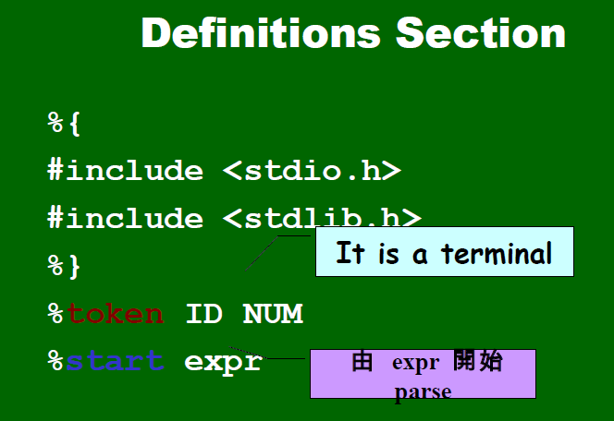
expr is start symbol

Slide 8
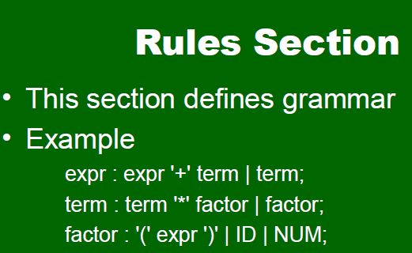
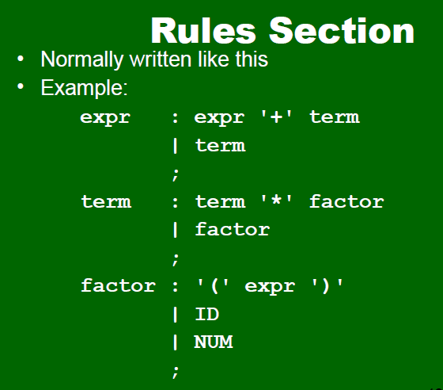

Slide 9
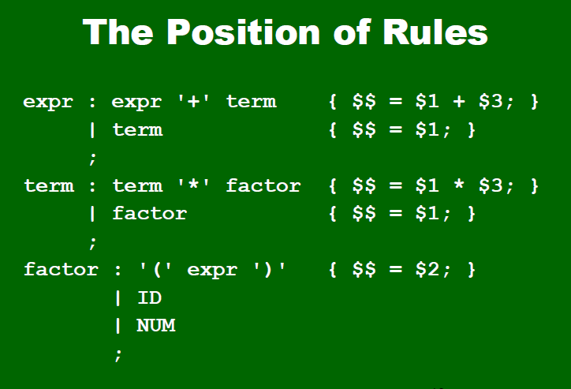
$$
$1
$2
$3

Slide 10
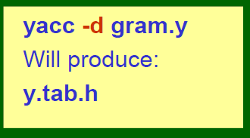
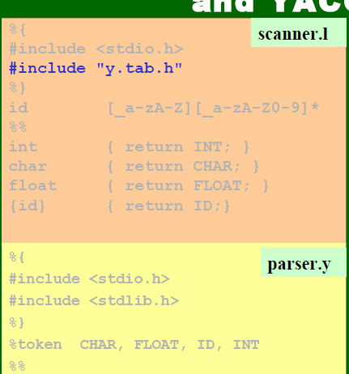

Slide 11
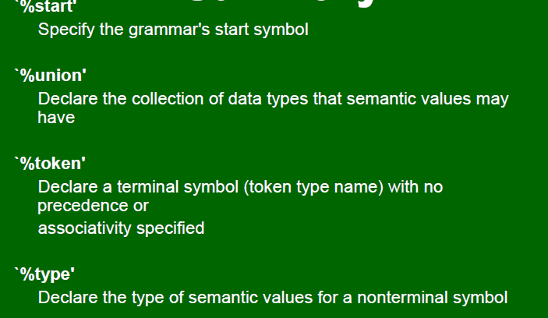
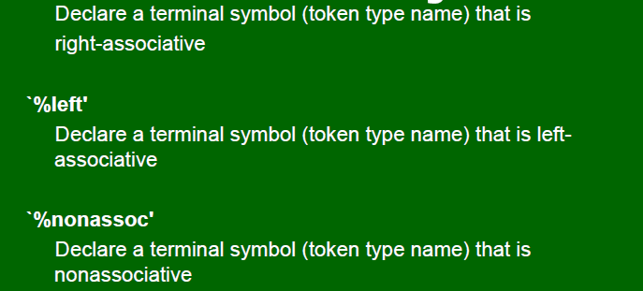
YACC declaration
%right

Slide 12
The user must supply an integer-valued function yylex()
that implements the lexical analyzer (scanner).
• If there is a value associated with the token, it should be
assigned to the external variable yylval.
• The token error is reserved for error handling.
• Token numbers : These may be chosen by the user if desired. The default is:
– chosen by yacc [in a file y.tab.h]
– the token no. for a literal is its ASCII value
– other tokens are assigned numbers starting at 257
– the endmarker must have a number zero or negative.
• Generate y.tab.h using ‘yacc -d’

Slide 13
%{
#include <stdlib.h>
void yyerror(char *);
#include "y.tab.h"
%}
%%
/* variables */
[a-z] {
yylval = *yytext - 'a';
return VARIABLE;
}
/* integers */
[0-9]+ {
yylval = atoi(yytext);
return INTEGER;
}
/* operators */
[-+()=/*\n] { return *yytext; }
/* skip whitespace */
[ \t] ;
/* anything else is an error */
. yyerror("invalid character");
%%
int yywrap(void) {
return 1;
}
definition of tokens
return tokens
The lexical analyzer returns VARIABLE and INTEGER tokens. For variables yylval specifies an index to the symbol table sym. When INTEGER tokens are returned, yylval contains the number scanned.

Slide 14
%token INTEGER VARIABLE
%left '+' '-'
%left '*' '/'
%{
void yyerror(char *);
int yylex(void);
int sym[26];
%}
%%
program:
program statement '\n'
|
;
statement:
expr { printf("%d\n", $1); }
| VARIABLE '=' expr { sym[$1] = $3; }
;
The tokens for INTEGER and VARIABLE are utilized by yacc to create #defines in y.tab.h for use in lex.
%left, for left-associative or %right for right associative
expr:
INTEGER
| VARIABLE { $$ = sym[$1]; }
| expr '+' expr { $$ = $1 + $3; }
| expr '-' expr { $$ = $1 - $3; }
| expr '*' expr { $$ = $1 * $3; }
| expr '/' expr { $$ = $1 / $3; }
| '(' expr ')' { $$ = $2; }
;
%%
void yyerror(char *s) {
fprintf(stderr, "%s\n", s);
return 0;
}
int main(void) {
yyparse();
return 0;
}

Slide 15
Thermostat Controller
heat on
Heater on!
heat off
Heater off!
target temperature 22
New temperature set!
commands: /* empty */
| commands command
;
command:
heat_switch
|
target_set
;
heat_switch:
TOKHEAT STATE
{
printf("\tHeat turned on/off");
}
;
target_set:
TOKTARGET TOKTEMPERATURE NUMBER
{
printf("\tTemperature set\n");
}
;
Lex code
%{
#include <stdio.h>
#include "y.tab.h"
%}
%token NUMBER TOKHEAT STATE TOKTARGET TOKTEMPERATURE
%%
[0-9]+ return NUMBER;
heat return TOKHEAT;
on|off return STATE;
target return TOKTARGET;
temperature return TOKTEMP;
\n /* ignore end of line */;
[ \t]+ /* ignore whitespace */;
%%
heat_switch:
TOKHEAT STATE
{
if($2)
printf("\tHeat turned on\n");
else
printf("\tHeat turned off\n");
}
;
printf("\tTemperature set to %d\n",$3);
yylval=!strcmp(yytext,"on"); return STATE;

Slide 16
%{
#include <stdio.h>
#include <string.h>
void yyerror(const char *str)
{
fprintf(stderr,"error: %s\n",str);
}
int yywrap()
{
return 1;
}
main()
{
yyparse();
}
%}

